Slide 1
The Processor Status and the FLAGS Register
Course Code: COE 3205
Course Title: Computer Organization & Architecture
Dept. of Computer Science
Faculty of Science and Technology
Lecturer No: | 06 | Week No: | 06 | Semester: | Fall 21-22
Lecturer: | Syeda Anika Tasnim anika.tasnim@aiub.edu

Slide 2
Lecture Outline
Overview
Learning Objective
The FLAGS Register
The Status Flags
Overflow
How Instructions Affect the Flags
DEBUG Program

Slide 3
Overview
Computer’s decision making ability makes it unique than other devices.
The CPU circuits perform decision making based on the processor’s current state.
The 8086 processor’s state is represented with nine individual bits or flags.
The 8086 takes decision based on the flags value.
The flags are placed in the FLAGS register.
Status flags: Reflects the result of computation.
Control flags: used to enable or disable certain operations of processor

Slide 4
Learning Objective
How flags are effected by the machine instructions.
DOS program DEBUG
Display registers, flags and memory locations using DEBUG.

Slide 5
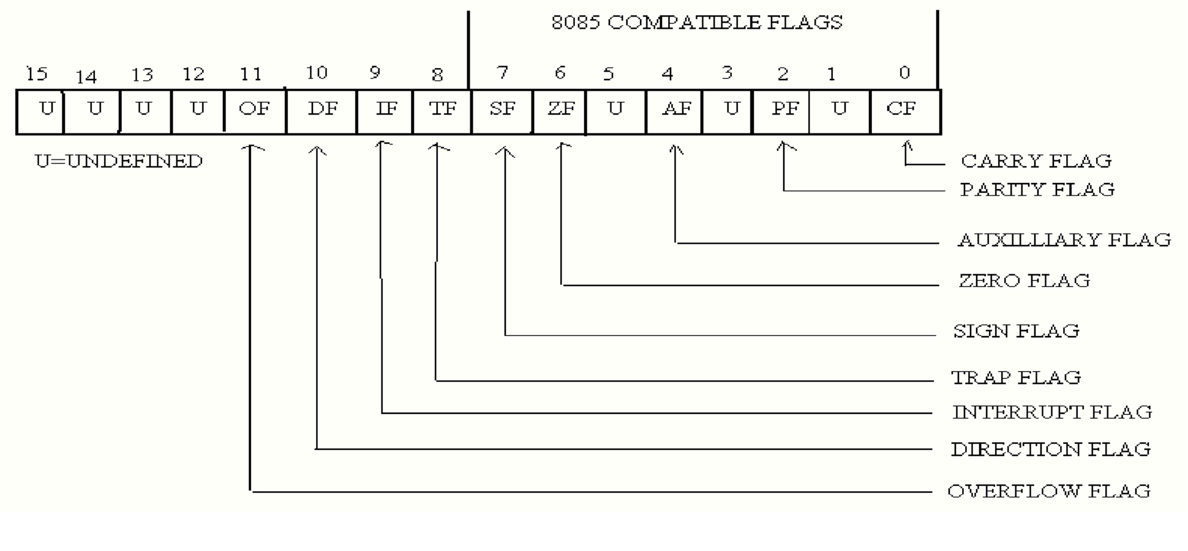
The FLAGS Register
Status Flags: bit 0, 2, 4, 6, 7 and 11
Control Flags: bit 8, 9 and 10
*** bit 1,3,5,12,13,14,15 has no significance

Slide 6
The Status Flags (1/2)
Flags | Descriptions
Carry Flag | CF=1 If there is a carry out from the most significant bit (MSB) on addition. CF=1 If there is a borrow into the most significant bit MSB on subtraction. Otherwise CF=0
Parity Flag | Even Parity:PF=1, if low byte of a result has even number of one bits [e.g. 1111000011] Odd Parity: PF=0, if low byte of a result has an odd number of one bits [e.g. 1111000111] e.g FFFF is odd parity and FFFE is even parity
Auxiliary carry Flag | AF=1, if there is a carry out from bit 3 on addition or AF=1, if there is a borrow from bit 3 on subtraction.

Slide 7
The Status Flags (2/2)
Zero Flag | ZF=1 for a zero result. e.g. for AX-AX= Zero, thus, ZF=1 ZF=0 for a non-zero result
Sign Flag | SF=1 if MSB of a result is 1. that is the result is negative SF=0 if the MSB is zero
Overflow Flag | OF=1 if signed overflow occurred otherwise it is 0 (Zero)

Slide 8
Overflow
The range of numbers can be represented is limited!
Range of signed numbers can be represented in 16-bit word is -32768 to 32767
For 8 bit byte it is -128 to 127
For unsigned number, the range for word is 0 to 65535.
For byte it is 0 to 255
If an Operations falls outside these range, overflow occurs and truncated result that is saved and will be incorrect.

Slide 9
Overflow
Possible Overflows
If we perform an arithmetic operation such as addition, there are four possible consequences:
No overflow
Signed overflow only
Unsigned overflows only
Both signed and unsigned overflows

Slide 10
Overflow
Example: Unsigned but not Signed Overflow
AX , FFFFh = 1111111111111111 [-1]
BX , 0001h = 0000000000000001 [+1]
=================
ADD AX,BX 1 0000 0000 0000 0000
For an unsigned interpretation, the correct answer is 10000h or 65536.but this is out of range and 1 is carried out of msb and finally AX= 0000h[WRONG!] thus UNSIGNED overflow occurred.
However, for a signed number the answer is correct FFFFh+0001h or -1+1=0. So no signed overflow occurred.

Slide 11
Overflow
Example: Signed but not Unsigned Overflow
AX 7FFFh = 0111111111111111
BX 7FFFh = 0111111111111111
=================
ADD AX,BX 1111111111111110 [FFFEh = -2]
For singed and unsigned interpretation, 7FFFh= 32767 thus 7FFFh+7FFFh= 32767+32767 = 65534 [out of range for signed numbers!]. So signed overflow occurred.
However, an unsigned interpretation the answer is correct FFFEh or 65534

Slide 12
Overflow
Processor Overflow Indication
OF = 1 for a signed overflow
CF = 1 for unsigned overflow
Unsigned Overflow:
On addition: the unsigned overflow occurs when there is a carry out of the MSB.
Meaning the correct answer is bigger than largest unsigned number i.e. FFFFh or FFh
On Subtraction: If there is a borrow into the MSB
Meaning the correct answer is Smaller than 0.

Slide 13
Overflow
Signed Overflow:
On addition: On addition with the numbers with the same sign, signed overflow occurs while SUM has different sign.
However, overflow is impossible in addition of numbers with different sign.
On subtraction: Subtraction of numbers with different signs is like adding numbers of the same sign. Signed overflow occurs if the result has different sign than expected.

Slide 14
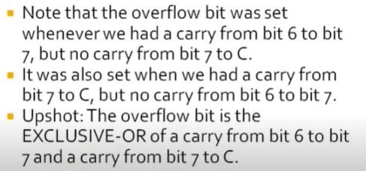
Overflow
Overflow Summary on Addition:

Slide 15
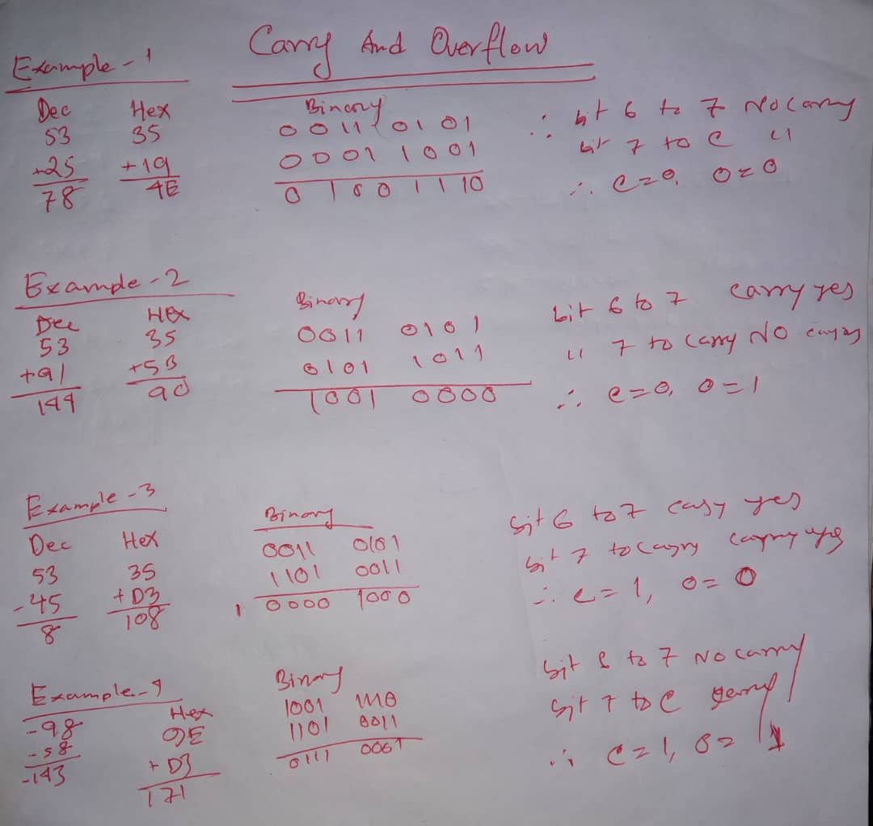
Overflow
Overflow More Examples on Addition:

Slide 16
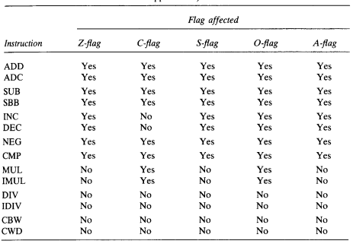
How Instructions Affect the Flags

Slide 17
How Instructions Affect the Flags
Examples
ADD AX,BX , WHERE AX CONTAINS FFFFH AND BX CONTAINS FFFFH.
FFFFh
₊ FFFFh
=========
1FFFEh
The result stored in AX is FFFEh = 1111 1111 1111 1110
SF = 1, because msb is 1
PF = 0, because there are 7 of 1 bits in the low byte of the result
ZF = 0, because the result is non zero
CF = 1, because there is a carry out of the msb on addition
OF = 0, because the sign of the stored result is the same as that of the numbers being added( as a binary addition, there is a carry into the msb and also a carry out)

Slide 18
How Instructions Affect the Flags
Examples
2. ADD AL, BL ,WHERE AL CONTAINS 80H AND BL CONTAINS 80H.
80h
+ 80h
==========
1 00h
The result stored in AL is 00h.
SF = 0 because the msb is 0
PF = 1 because all the bits in the result are 0
ZF = 1 because the result is 0
CF = 1 because there is a carry out of the msb on the addition
OF = 1 because the numbers being added are both negative, but the result is 0(as a binary addition, there is no carry out into the msb but there is a carry out.)

Slide 19
How Instructions Affect the Flags
Examples
3. NEG AX, WHERE AX CONTAINS 8000H.
8000h = 1000 0000 0000 0000
one’s complement = 0111 1111 1111 1111
two’s complement = + 1
===========================
1000 0000 0000 0000 = 8000h
The result is stored in AX is 8000h
SF = 1
PF = 1
ZF = 0
CF = 1 because for NEG CF is always 1 unless the result is 0
OF = 1 because the result is 8000h; when a number is negated , we would expect a sign change, but because 8000h is its own two’s complement , there is no sign change.

Slide 20
How Instructions Affect the Flags
Task : Solve the Following and Show the Effects on Flag Registers
SUB AX,BX , WHERE AX CONTAINS 8000H AND BX CONTAINS 0001H.
INC AL, WHERE AL CONTAINS FFH.
MOV AX, -5 .

Slide 21
DEBUGING Program
Debug is used to step through a program, display and change the registers and memory.
It is possible to enter assembly code directly. DEBUG then converts it to machine code and stores it in memory.

Slide 22
DEBUGING Program
Program 1: Checking Flags
.MODEL SMALL
.STACK 100H
.DATA
.CODE
MAIN PROC
MOV AX,4000H ;AX=4000h
ADD AX,AX ;AX=8000h
SUB AX,0FFFFH ;AX=8001h
NEG AX ;AX=7FFFh
INC AX ;AX=8000h
MOV AH,4CH
INT 21H
MAIN ENDP
END MAIN

Slide 23
DEBUGING Program
DEBUG Flag Symbols
Status Flag |  | Set (1) Symbol | Clear (0) Symbol
CF |  | CY (carry) | NC (no carry)
Pf |  | PE (even parity) | PO (odd parity)
AF |  | AC (auxiliary carry) | NA (No Auxiliary carry)
ZF |  | ZR (zero) | NZ (nonzero)
SF |  | NG (negative) | PL (plus)
OF |  | OV (overflow) | NV (no overflow}
Control Flag
DF | DN (down) |  | UP (up)
IF | El (enable interrupts) |  | DI (Disable interrupt)

Slide 24
Books
Assembly Language Programing and Organization of the IBM PC
Ytha Yu
Charles Marut

Slide 25
References
Flag Register Details
https://www.youtube.com/watch?v=-LXc6IvtsfI
https://www.youtube.com/watch?v=vkpGK5bZbSY&list=RDCMUCCU6xxwO9uJuFieylWL2lSA&start_radio=1&t=27
Carry and Overflow Details
https://www.youtube.com/watch?v=9cXe_T99nL4

